Slide 1
Adversarial Thinking Module
Lesson 1: Intro to Adversarial Thinking
Notes:
These materials were made possible by a grant from the NSA National Cybersecurity Curriculum Program, Round 1.
All pictures and graphics used in these materials carry a Creative Commons license.
The slides are Section 508 compliant.
These materials were created by:
Seth Hamman, Ph.D.
Director, Center for the Advancement of Cybersecurity
Associate Professor of Cyber Operations and Computer Science
Cedarville University
Email: shamman@cedarville.edu
Phone: 937-766-7686
Please contact the author with any errata, suggestions for improvement, or to provide any other feedback.

Slide 2
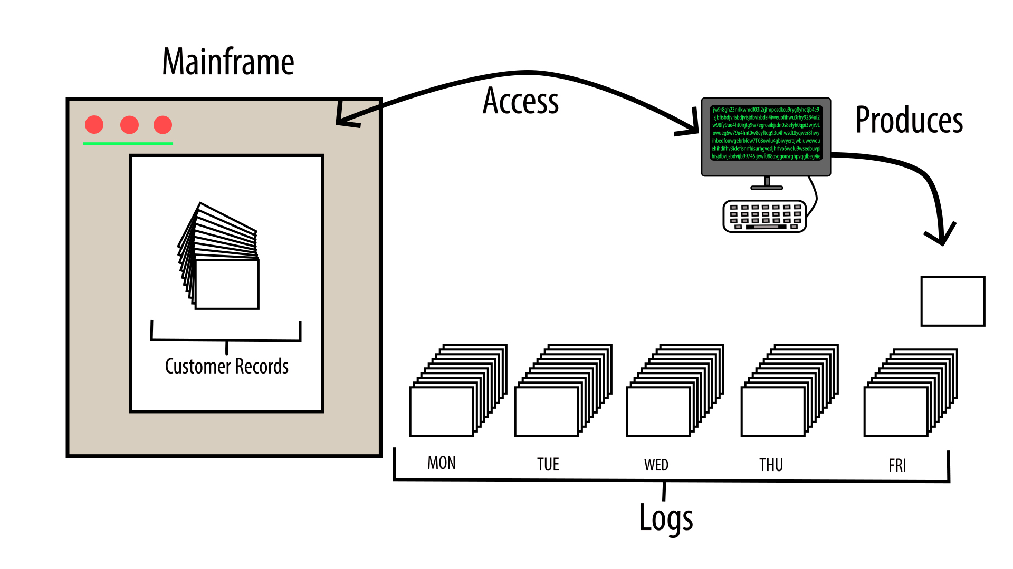
Exercise: Data Breach
Notes:
Slide notes:
See Data Breach Exercise.docx and Data Breach Exercise Pretest – Instructor Notes.docx

Slide 3

Do you see a person skilled in his work? He will stand in the presence of kings. (Proverbs 22:29)
Notes:
Slide notes:
This is an ancient Jewish proverb and it meant to inspire students to be highly skilled in cybersecurity. Adversarial thinking is the fundamental skill of cybersecurity.

Slide 4


The Essence of Cybersecurity:
Notes:
Slide notes:
This and the next few slides boil cybersecurity down to its essence…

Slide 5
Take Away the Computer...
Criminal Justice
Criminology
Public Policy
Military Studies
etc.

Slide 6
Take Away the Bad Guys...
Computer Science
Computer Engineering
Software Engineering
Information Technology
etc.

Slide 7
The following video will flesh this out a little more...
The Essence of Cybersecurity:

Slide 8

The 3 B’s of Security
Notes:
Slide objectives:
Engage the students attention.
Motivate cybersecurity as fundamentally an adversarial conflict.
Slide Notes:
This YouTube video was produced at Cedarville University in 2018 and carries a Creative Commons license
This is the direct link to the video:
https://youtu.be/2s8KrLN7GRE

Slide 9
The 3 B’s of Security - Recap
Every security context contains 3 fundamental components:
Bounty – valuables that must be protected from bad guys
Bad Guys – persons who seek to get their hands on the bounty
Barriers – obstacles placed between the bad guys and the bounty
Q1: What are the 3 B’s in a medieval kingdom context?
Q2: What are the 3 B’s in a brick-and-mortar bank context?
Q3: What are the 3 B’s in a cyberspace context?
Notes:
Slide objectives:
Grab students attention by engaging their imaginations
Demystify the practice of cybersecurity by…
Relating it to something ancient (medieval kingdom) and something familiar and tangible (bank security)
Breaking it down into very simple and fundamental components
Slide notes:
These questions are intended to be used as a brainstorming exercise.
Here are some possible answers to the questions posed to students…
A1:
Bounty: gold, silver, jewels, relics, etc.
Bad Guys: marauders, enemies, bandits, etc.
Barriers: moat, castle walls, draw bridge, knights, etc.
A2:
Bounty: cash, gold, silver, safe deposit boxes, etc.
Bad Guys: armed robbers, sophisticated thieves, etc.
Barriers: security cameras, steel safe, security guards, etc.
A3:
Bounty: information, data, bits and bytes, etc.
Bad Guys: hackers, enemy nation states, script kiddies, hacktivists, etc.
Barriers: firewalls, operating systems, authentication and authorization mechanisms, antivirus software, cybersecurity professionals, etc.

Slide 10
Cyberspace Security (AKA Cybersecurity)
Cyberspace is the more difficult context to secure, and so far, the bad guys are enjoying their strategic advantage.
Q1: In what ways is cyberspace different from physical space?
Q2: In physical space, we worry about bad guys stealing the bounty…What might bad guys do with cyberspace bounty (AKA data)?
Notes:
Slide objectives:
Illustrate the nuances of cybersecurity
Illustrate the special challenges posed by cybersecurity
Slide notes:
These questions are intended to be used as a brainstorming exercise.
Here are some possible answers to the questions posed to students…
A1:
Distanceless
Digital
Dynamic
Dark
(see https://www.ted.com/talks/seth_hamman_guardian_of_the_cyber_galaxy)
A2:
Copying data – this is like stealing but it does not deprive the owner of his possession
Modifying data – e.g., changing a bank account balance
Deleting data – e.g., destroying records

Slide 11
Bottom Line
Cybersecurity is only necessary because of the existence of people who deliberately attack computer systems and networks.
We call these people HACKERS.

Slide 12

What a Difference Hackers Make!
IT in a world WITHOUT hackers... | IT in a world WITH hackers...
Random mistakes and failures result in the loss of data and the need for restoring data from backups. | Deliberate attacks encrypt production data AND data backups and hold them for ransom.
Software bugs frustrate users. | Malware exploit bugs to take over users’ computers.
Operating Systems crash unexpectedly. | OS rootkits make it appear that things are working fine when they aren’t.
New employees need to be trained in phone etiquette. | New employees need to be warned about social engineering tactics.
Need an IT Help Desk to troubleshoot computer problems. | Need a Security Operations Center to try to prevent an IT catastrophe.
Simple log audits can be used to determine the cause of incidents. | In-depth forensics are needed to determine the cause of incidents.
Notes:
Slide notes:
Quick points of contrast showing that hackers make everything MUCH more difficult!

Slide 13
Computer Hackers and Cybersecurity
Cyber adversaries are what differentiates cybersecurity from other technical disciplines such as computer science and information technology management.
At its heart, cybersecurity is an adversarial conflict between the bad guys who are trying to get their hands on the bounty and the good guys who are trying to protect the bounty.
In order to practice cybersecurity effectively, one must pay careful attention to what computer hackers are thinking:
What are their objectives?
How might they go about achieving their objectives?
This mindset is known as adversarial thinking.
Notes:
Slide objectives:
Drive home the importance of human adversaries to the discipline of cybersecurity
Slide notes:
Perhaps because cybersecurity arose out of the technical discipline of computer science and not out of a social science, there tends to be more emphasis placed on the technical aspects of the discipline than on the human elements.
The point of this slide (and really the entire module) is to help correct that imbalance by pointing out one simple fact:
Without cyber adversaries, there is no such thing as cybersecurity

Slide 14
In other words, if this circle represents cybersecurity...
Adversarial
Thinking
...because cybersecurity is all about stopping the bad guys.

Slide 15
The Hallmark of the Discipline of Cybersecurity
Discipline | Approach | Fundament Mindset
Mathematics | Constructing Proofs | Logical Thinking
Computer Science | Writing Programs | Algorithmic Thinking
Cybersecurity | Security Practices | Adversarial Thinking
Notes:
Slide objectives:
Drive home the centrality of adversarial thinking to the discipline of cybersecurity
Slide notes:
Example slide script:
“There are certain academic disciplines that have become synonymous with a particular way of thinking, because in order to excel at them, you must possess a special mindset.
“Take, for example, the discipline of mathematics. Mathematicians start with axioms and then make logical inferences so that they can prove theorems. They use proof techniques like proof by induction, proof by contradiction, and direct proofs, all of which require high degrees of logical rigor. Therefore, logical thinking and the discipline of mathematics go hand-in-hand.
“Another example is the discipline of computer science. Computer scientists design algorithms in order to solve problems. Algorithms are a sequence of detailed instructions targeted at an abstract problem, that when carefully followed, produce correct solutions on particular inputs. So computer science over the years has become synonymous with what we call algorithmic thinking.
“The discipline of cybersecurity has also become synonymous with a particular and unique mindset. For cybersecurity, we call it adversarial thinking.”

Slide 16
But what exactly does adversarial thinking mean?
In order to be sure we are learning it, we must be able to define it.
It boils down to the definition of thinking...
Notes:
Slide objectives:
Illustrate the need for a good definition of adversarial thinking.
Slide notes:
Having established the centrality of adversarial thinking to cybersecurity, we now turn to learning how to do adversarial thinking.
As instructors, without a good definition of adversarial thinking, we cannot:
Articulate appropriate learning outcomes
Create curriculum content to teach adversarial thinking
Assess students’ abilities to conduct adversarial thinking

Slide 17
Cognitive Psychology
Cognitive psychology is “the study of higher mental processes such as attention, language use, memory, perception, problem solving, and thinking.” (Source: American Psychological Association)
In other words, cognitive psychology studies what it really means to think, so it can help unpack “thinking like a hacker.”
Robert Sternberg is a famous cognitive psychologist who proposed the triarchic theory of intelligence in the 1980’s.
The triarchic (tri meaning three) theory identifies three main aspects of intelligence.
There are many competing theories, but Sternberg’s is appreciated for its simplicity and explanatory power.
Notes:
Slide objectives:
Make the case that cognitive psychology is a useful tool for defining adversarial thinking.
Introduce Sternberg’s triarchic theory.
Slide notes:
Example slide script:
“The discipline of cognitive psychology, which studies the mind, can help us define adversarial thinking because it is concerned with the question, ‘What does it mean to think?’
“Applying cognitive psychology therefore might help us unpack what it means to ‘think like a hacker.’
“Robert Sternberg is a cognitive psychologist who is famous for his triarchic theory of intelligence, which identifies three distinct aspects of the intellect.
“Sternberg’s theory has withstood the test of time because it is simple and it sheds light on some phenomena we observe in the world.”

Slide 18
Sternberg’s Triarchic Theory
Area | Description | Popular Conception | Exemplar
Analytical | Mathematical ability and logical reasoning | Book smarts | Einstein
Creative | The ability to make unique connections and original insights | Creative ability | Van Gogh
Practical | The ability to plan, strategize, and accomplish goals | Street smarts | Napoleon
Notes:
Slide objectives:
Illustrate the three areas of the triarchic theory.
Slide notes:
Example slide script:
“Sternberg’s three areas are the analytical, the creative, and the practical.
“The analytical area captures the popular notion of intelligence and coincides with IQ. It includes mathematical ability and logical reasoning. We can think of it as book smarts.
“The creative area of the intellect includes the ability to make unique connections and to see the world in original ways. Artists, authors, and musicians excel in this aspect of the intellect. We can think of it as imaginative and creative thinking.
“Practical intelligence includes the ability to plan, strategize, and accomplish goals. Successful CEOs and military leaders have high degrees of practical intelligence.
“The three areas of the triarchic theory are meant to capture different modes of intelligence that all people possess to a greater or lesser extent. The three areas are not necessarily correlated with one another—a person might be above or below average in any given area independent of the other areas. The model is useful to help explain why some people succeed in some arenas and fail in others. Sternberg notes that many students with high analytical intelligence do very well in the highly structured world of undergraduate education, but they struggle as graduate students because they lack creative and practical intelligence, both of which are paramount for conducting and completing original research.”
(source: “Teaching Adversarial Thinking for Cybersecurity”)

Slide 19
The Triarchic Theory Illustrated
Area | Question to Explore this Way of Thinking
Analytical | If I need 128 credit hours to graduate from college, how many credit hours do I need to average per semester?
Creative | How can I write ONE essay but turn it in for BOTH my Psychology and my English Literature writing assignments?
Practical | How can I go about landing my dream job when I graduate from college?
Notes:
Slide notes:
If students pause to consider each of the questions posed, they will “feel” how their brain is working in different ways to come up with the answers. For the first, they very logically try to solve a math problem in a step-by-step manner. For the second, they will feel their brain trying to work out the intersection between two very different things. For the third, they have to imagine potential obstacles and formulate a path forward.

Slide 20
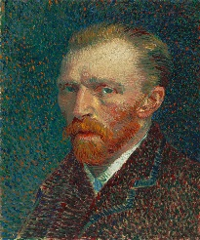


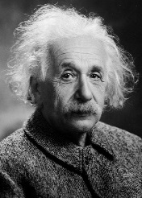
Triarchic Theory Applied to Hackers
Q2: How does the ability to make unique and creative connections help him break into systems?
Creative
Practical
Analytical
Q3: How does the ability to plan, strategize, and overcome obstacles contribute to his success in hacking?
Q1: What contributions does his “book smarts” make to his hacking prowess?
Notes:
Slide objectives:
Help the students explore the triarchic theory’s relationship to the minds of hackers.
Slide notes:
These questions are intended to be used as a brainstorming exercise.
Here are some possible answers to the questions posed to students…
A1: Strong programming skills, intimate familiarity with operating systems and computer networks, understanding low-level details of computer hardware and software, etc.
A2: Thinking of unexpected ways around security barriers, using software and computer networking protocols in unusual ways, breaking norms, etc.
A3: Planning an attack, remaining hidden on systems, outwitting security personnel, etc.

Slide 21
Triarchic Theory and Adversarial Thinking
Area | Hacker Application | Example | Summary
Analytical | Understanding technology at a deep level, including computer networking protocols, programming languages, and operating systems. | Command-line Kung Fu | Technological Capabilities
Creative | Identifying unsafe security assumptions through manipulating and stretching technology in unexpected ways. | XSS Attacks | Unconventional Perspectives
Practical | Reasoning strategically to plan and execute attacks, evade detection, and overcome obstacles. | Trojan Horse Malware | Strategic Reasoning
Notes:
Slide objectives:
Summarize the triarchic theory’s relationship to hacking.
Slide notes:
Example slide script:
“Hacking involves detailed knowledge of many highly technical aspects of computing, including computer networking protocols, assembly language programming, and operating systems. In Sternberg’s paradigm, this technical knack exhibited by computer hackers ties into the analytical component of their intellect. In this case, their analytical gifts translate into an unusual facility with computers and technology. Having strong technical abilities is vital to hackers because many kinds of cyber attacks involve overcoming significant technological hurdles. Here are a few examples: to infiltrate a computer network, a hacker may need to construct precisely malformed network packets; to exploit a programming flaw, a hacker may have to tediously code a buffer overflow attack; and to remain undetected on a system, a hacker might need to modify an operating system’s libraries.
“Creativity is at the core of the “hacker mindset.” While fiction writers excel at creating original stories that capture the imagination, hackers excel at creating original exploits that bend technology in unexpected ways. Both are manifestations of the same root—they involve seeing the world in a unique way, and the ability “to put old information together in a new way,” as Sternberg puts it. While most technologists are concerned with making systems work, hackers are obsessed with pushing the limits of systems and exploring possibilities that many people would never consider. This aspect of hacking is the main connection between the pejorative way the term hacker is today, and the original, complimentary term from a previous era which connoted being highly skilled in the art of computer programming.
“The practical component of Sternberg’s triarchic theory is the aspect of the intellect that involves planning, strategizing, and overcoming obstacles to accomplish goals. While script kiddies are known to indiscriminately fire point-and-click exploits at random in hopes of finding unpatched systems, more highly skilled hackers select targets, conduct reconnaissance, carefully plan their attacks, and meticulously cover their tracks. In general, hackers attempt to use their time and resources wisely, and they strive to outwit security personnel. A researcher who interviewed hackers recorded, ‘One [hacker] described how he attempted to anticipate the moves of his adversary [security personnel] by stating, “how can I predict, how can I anticipate what they’re going to do?”’’
(source: “Teaching Adversarial Thinking for Cybersecurity”)

Slide 22
Before we asked what exactly does adversarial thinking mean.
Now, using the model of the triarchic theory, we can come up with a precise definition...

Slide 23
Adversarial Thinking Defined
Definition:
Adversarial thinking is the ability to embody the technological capabilities, the unconventional perspectives, and the strategic reasoning of hackers.
To the extent a person can do this, she will be able to:
Compete with hackers on a level playing field (analytical)
Find and fix vulnerabilities before hackers have an opportunity to exploit them (creative)
Anticipate future attacks, thwart attacks in progress (practical)
Notes:
Slide objectives:
Define the term adversarial thinking.
Slide notes:
This definition comes from the “Teaching Adversarial Thinking for Cybersecurity” paper.

Slide 24
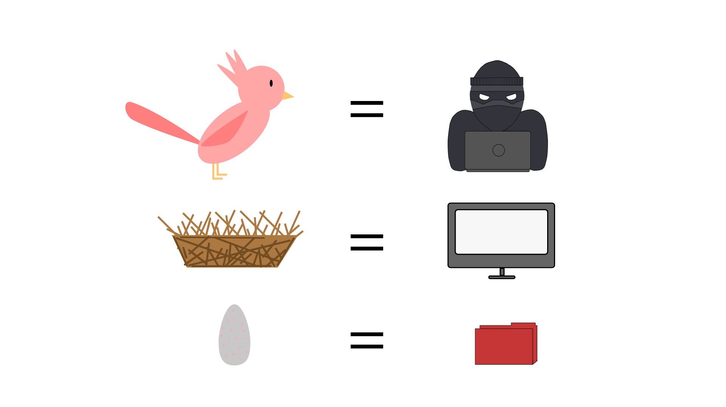
Exercise – The Cuckoo’s Egg
Notes:
Slide notes:
See Illustrating Adversarial Thinking Exercise.docx and Illustrating Adversarial Thinking Exercise – Instructor Notes.docx

Slide 25


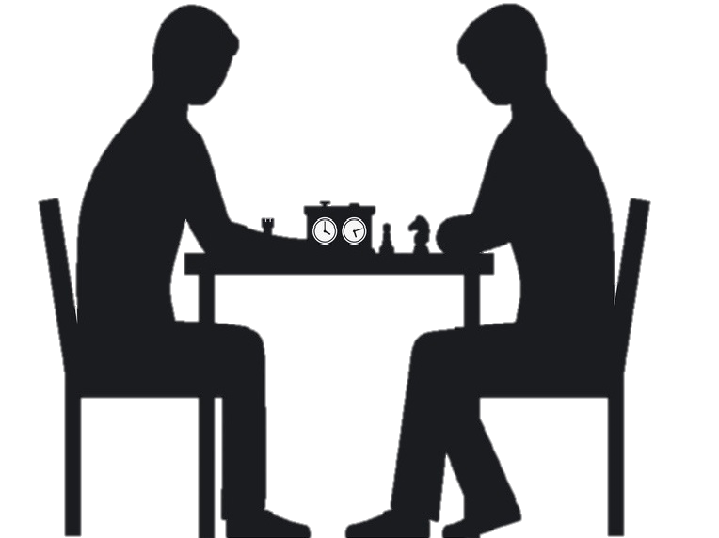
A solid cybersecurity education must equip you for...
The Technological Battle of Might
The Creative Battle of Skill
The Strategic Battle of Wits
Notes:
Slide notes:
Adversarial thinking boils down to 3 core components, and each is important in a different way. This slide can be connected in a vivid and memorable way to The Princess Bride film where the masked hero pursues the princess who is being held hostage and has to overcome 3 bad guys before rescuing her: one is a strong giant, one is a master swordsman, and one is a brilliant strategist.

Slide 26
Bottom Line
If we get so focused on any one cybersecurity best practice, technology, tool, etc., that we forget about the bad guys, we do so at our own peril.
We must always remember The Reason it All Exists!
Notes:
Slide notes:
This helps solidify the point that we’ve been making – adversarial thinking is really what cybersecurity is all about.

Slide 27
Adversarial Thinking Learning Outcomes
Dimension | Learning Outcome | All About
Technological Capabilities | Understand computer technology at a deep level (e.g., networking protocols, programming languages, and operating systems). | Leveling the playing field
Unconventional Perspectives | Identify unconventional uses of software and protocols that could be exploited as attack vectors by hackers. | Employing the “hacker mindset”
Strategic Reasoning | Anticipate the strategic actions of hackers, including where, when, and how they might attack, and their tactics for evading detection. | Anticipating and thwarting attacks
Notes:
Slide objectives:
Illustrate concrete ways that adversarial thinking can be learned and assessed.
Slide notes:
Earlier in the slides we posed the questions:
How can you learn adversarial thinking?
How can you tell if you are good at adversarial thinking?
This table illustrates three concrete way that adversarial thinking can be addressed in an educational context.
The technological capabilities component of adversarial thinking is taught in the technical classes of a cyber curriculum, like operating systems, computer networks, C and Assembly programming, software reverse engineering, etc.
The unconventional perspectives component is typically taught by example. In fact, it probably more likely to be caught than taught. Students are exposed to this in hacking classes where they learn about creative attack vectors that hackers have used in the past and continue to use, such as SQL injection, IPv4 fragmentation, cross-site scripting, etc.
The strategic reasoning component is not normally addressed in cyber curriculums. This is the component that this module homes in on.

Slide 28
Strategic Reasoning
Of the three dimensions of adversarial thinking, the one most likely to be overlooked is the strategic dimension.
This adversarial thinking module seeks to develop students’ strategic reasoning abilities.
Q1: What are some activities that come to your mind when you think about strategic reasoning?
Notes:
Slide objectives:
Illustrate the need for strategic reasoning in cybersecurity.
Slide notes:
The strategic dimension of adversarial thinking is not being adequately addressed in the classroom because here is very little awareness of the need to teach strategic reasoning to cybersecurity students.
This question is intended to be used as a brainstorming exercise.
Here are some possible answers to the question posed to students…
A1: playing board games, warfare, business competitions, sports competitions (e.g., football), etc.

Slide 29
Game Theory
Game theory can be defined as the study of strategic reasoning.
Game theory does not refer to video games and board games.
Learning basic game theory concepts is a proven way to improve one’s strategic reasoning abilities.
Game theory is typically taught at universities in disciplines such as:
Economics – the “birthplace” of game theory, taught in the context of market competition
Military studies – taught in the United States service academies to inform warfare strategy
MBA programs – taught to future business leaders to help them make strategic decisions
Notes:
Slide objectives:
Motivating why it makes sense to learn about game theory in a cybersecurity course.
Slide notes:
This area of adversarial thinking is particularly promising because it is believed that, in general, a person’s ability to engage in strategic reasoning can be improved.
Teaching basic game theory helps improve people’s strategic thinking abilities, and is taught in military studies and business schools.
For examples, see:
The Air Force Academy, MSS 372: Wargaming Airpower
Yale University, MGT 525: Competitive Strategy
Indiana University, G750: Thinking Strategically

Slide 30
“Strategic thinking seems to be more like learning to windsurf, ski, or fly an airplane, activities that require people to learn skills which are unnatural but teachable, and less like weight-lifting or dunking a basketball, where performance is constrained by physical limits.” - Colin Camerer
Notes:
Slide objectives:
Encouraging the students that they can learn strategic thinking.
Slide notes:
Colin Camerer, author of the seminal text on behavioral game theory, writes, “Strategic thinking seems to be more like learning to windsurf, ski, or fly an airplane, activities that require people to learn skills which are unnatural but teachable, and less like weight-lifting or dunking a basketball, where performance is constrained by physical limits.”

Slide 31
Conclusion
Without bad guys trying to overcome the barriers in order to get their hands on the bounty, there is no such thing as cybersecurity.
Therefore, adversarial thinking is central to cybersecurity.
Strategic reasoning is one of three components of adversarial thinking.
Game theory is a proven way to improve ones’ strategic reasoning abilities.
In the remaining lessons in this module on adversarial thinking, we will learn the fundamentals of game theory!
Notes:
Slide objectives:
Providing a summary of the most important points of the lesson
Outlining the remainder of the module.
Slide notes:
Wrapping up the first lesson by reinforces the most important points while providing a segue to the next lesson.

